Slide 1


Slide 2
C# Applications
C#
.NET
.NET Core
Console
Asp .NET
Asp .NET Core
Console
WinForms
WinForms
WPF
WPF
Windows
Cross Platforms (Windows, Linux, macOS)

Slide 3
C# Web Applications
C#
.NET
.NET Core
Asp .NET Core
Asp .NET
Windows
Cross Platforms (Windows, Linux, macOS)

Slide 4
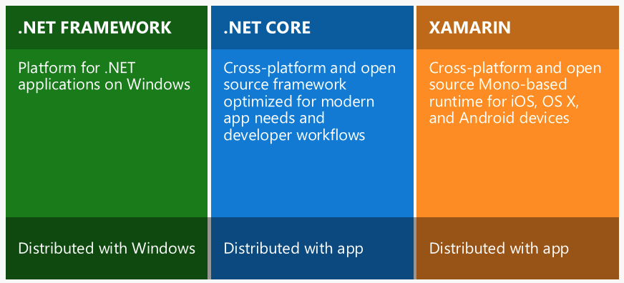
.NET, .NET Core and Xamarin

Slide 5
ASP.NET Core apps
Interactive web apps
RESTful API apps
MVC-patterned apps
real-time apps and more

Slide 6


